Slide 1



Workshop 2018
C# Scripting and Plugin Development
for Grasshopper
A Gentle Introduction to Hardcore Programming for Computational Design
LONG NGUYEN
Research Associate
Institute for Computational Design (ICD)
University of Stuttgart
26,27,28 / 04 / 2018

Slide 2
Mesh growth (continued)
Computational Complexity
Spatial Data Structures
Fast collision detection with R-Tree
Using external .NET Libraries
Day 3
28/04/2017

Slide 3
Mesh Growth
by subdivision and avoiding self-collision

Slide 4
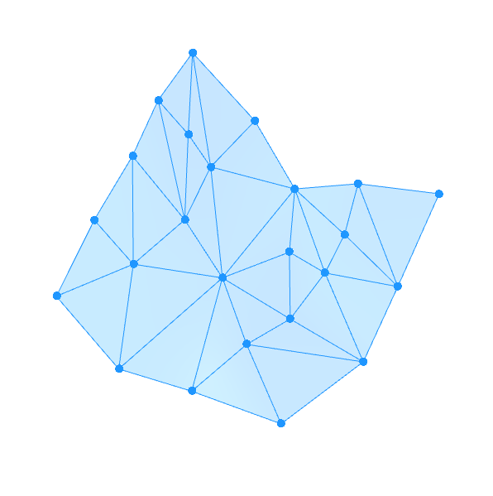
Two essential mechanisms:
Vertices push each other away (using sphere-sphere collision)
As an edge gets longer than a given threshold, it will be split into two shorter edges
Two extra mechanisms:
Edge Length constraint: Prevent an edge from getting too long
Bending resistance: Each pair of adjacent triangles will try to be flat

Slide 5
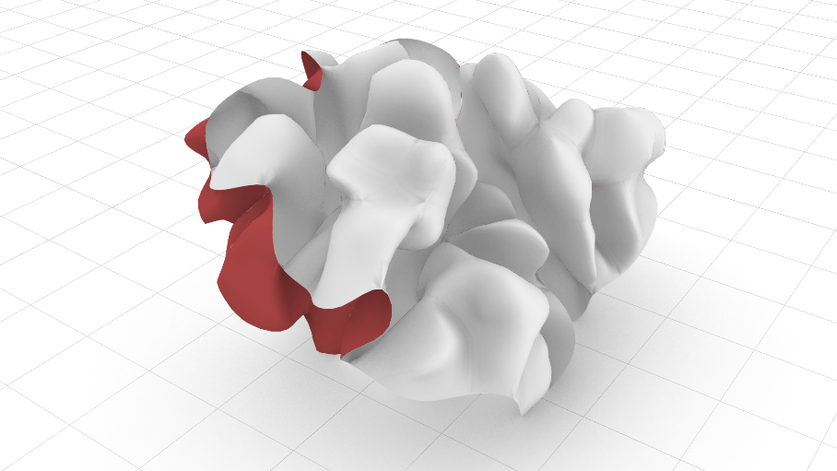
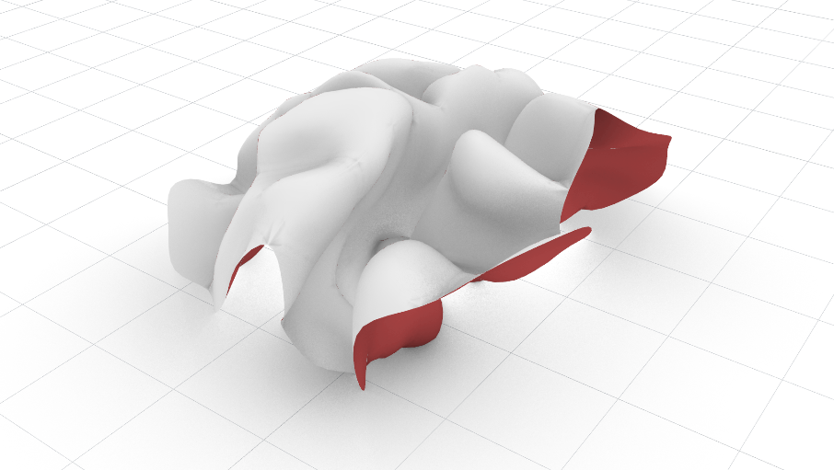
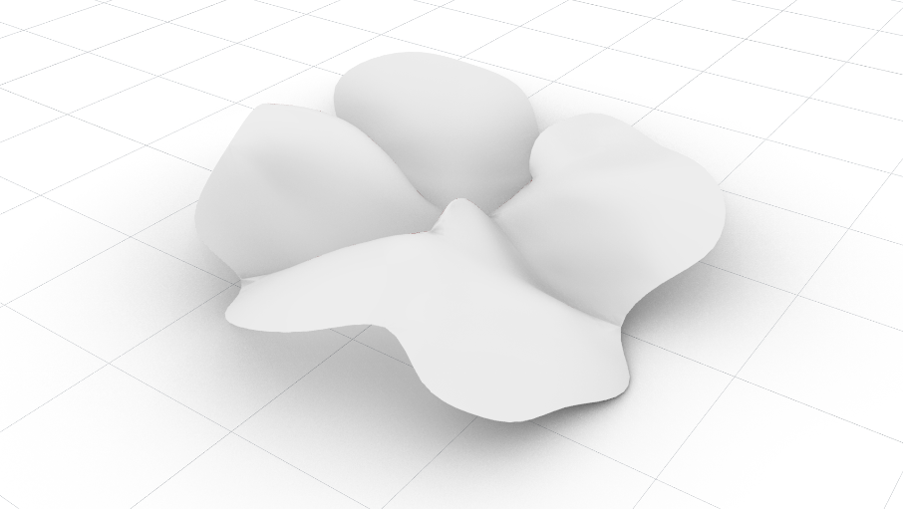
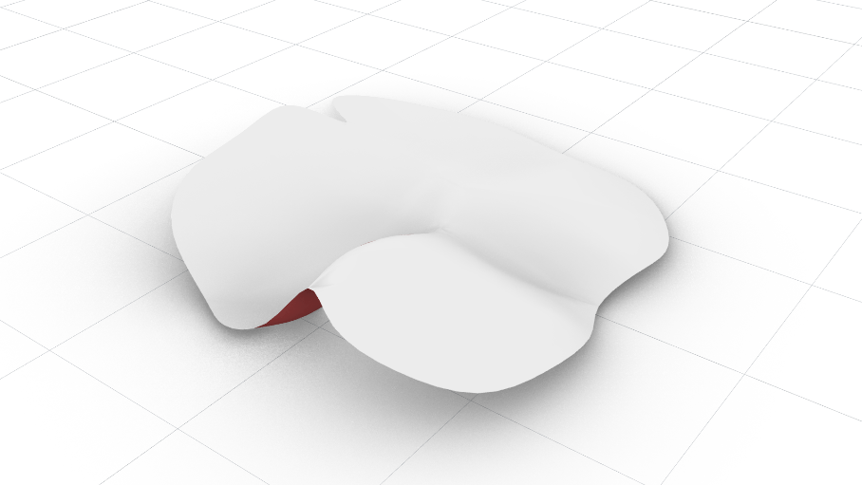
The Influence of Bending Resistance
No
bending resistance
Low
bending resistance
Moderate
bending resistance
High
bending resistance

Slide 6
Mesh in RhinoCommon

Slide 7
4
1
0
Faces[0] refers to v2, v4, v1
Faces[1] refers to v0, v3, v2, v1
Faces[2] refers to v2, v3, v5
2
0
1
2
3
5

Slide 8
Halfedge Mesh
An alternative way to represent a mesh

Slide 9
11
4
10
Each half-edge explicitly knows about:
- Its start vertex
- The previous & next half edges in the cycle
- The adjacent face
- Its sibling half-edge
1
0
9
8
5
3
4
2
2
0
1
Let’s examine halfEdge2
halfEdge2.StartVertex: 2
halfEdge2.NextHalfEdge: 4
halfEdge2.PreviousHalfEdge: 0
halfEdge2.AdjacentFace: 1
0
6
12
7
1
13
2
3
14
5
15

Slide 10
Obtaining the end vertices of a halfedge
j
…
k
…
k+1
i
int i = Mesh.Halfedges[k].StartVertex;
int j = Mesh.Halfedges[k + 1].StartVertex;

Slide 11
How to correctly combine different move vectors
Blend the vectors with equal ratio 1:1:1
a + b + c
Average =
3
b
1 a + 1 b + 1 c
Average =
3
c
a
What if we want to blend with ratio 2:1:1
2 a + 1 b + 1 c
Average =
4
How about 3:1:2
3 a + 1 b + 2 c
Average =
6

Slide 12
Spatial Data Structures

Slide 13
Finding the neighbours

Slide 14
Spatial Grid

Slide 15
Octree / Quadtree

Slide 16
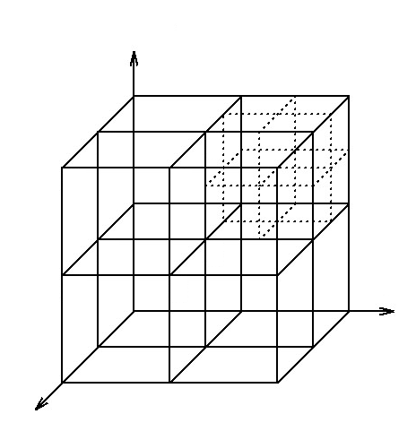
Octree / Quadtree

Slide 17
kd-tree

Slide 18
kd-tree depth (approximate)
16
8
8
4
4
4
4
2
2
2
2
2
2
2
2
1
1
1
1
1
1
1
1
1
1
1
1
1
1
1
1
Tree depth = log₂n

Slide 19
kd-tree: recursively search for neighbors

Slide 20
Computation time to find neighbours (approximate)
16
8
8
4
4
4
4
2
2
2
2
2
2
2
2
1
1
1
1
1
1
1
1
1
1
1
1
1
1
1
1
Computation time is proportional to tree depth, which is log₂n

Slide 21
Computation time comparision
Brute-force: n
kd-tree: log₂n
n
Speed-up factor:
log₂n
The more agents we use in the flocking simulation, the bigger the speedup factor will be !!!

Slide 22
R-Tree
R2
R6
F
L
R3
R1
A
G
B
H
E
R5
I
D
F
R4

Slide 23
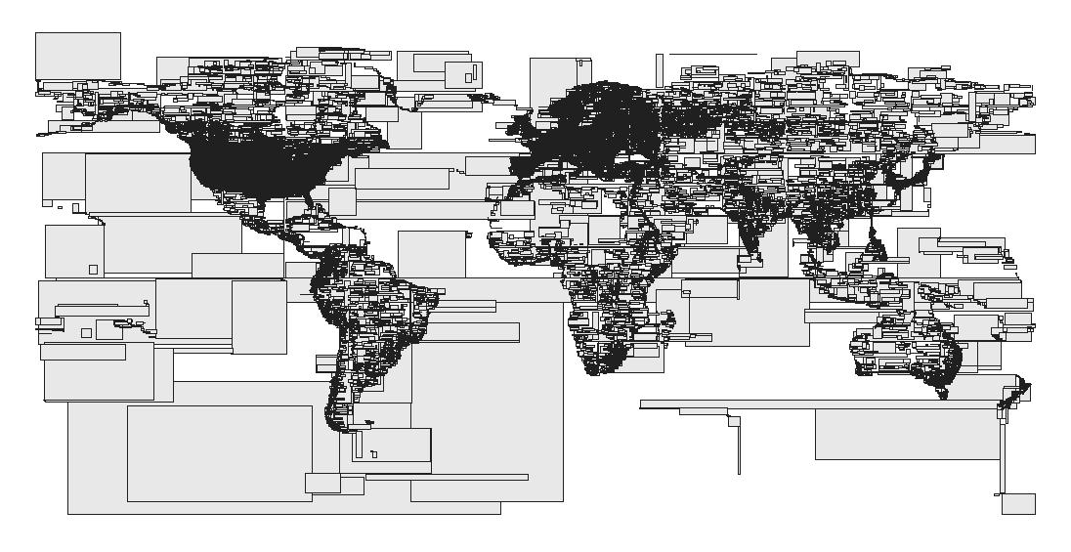
R-Tree
Source: http://osmopenlayers.blogspot.de

Slide 24
Bending Resistance
Target plane

Slide 25
Bending Resistance:
Obtaining the relevant vertex indices
j
p
k
q
k+1
i
int i = Mesh.Halfedges[k].StartVertex;
int j = Mesh.Halfedges[k + 1].StartVertex;
int p = Mesh.Halfedges[Mesh.Halfedges[k].PrevHalfedge].StartVertex;
Int q = Mesh.Halfedges[Mesh.Halfedges[k + 1].PrevHalfedge].StartVertex;

Slide 26
Using External Libraries
Using a .NET library in the C# Script Component
Use Python to access codes written in C#

Slide 27
private void RunScript(...)
{
if (iReset || system == null)
system = new MeshGrowthSystem(iStartingMesh);
system.Grow = iGrow;
system.MaxVertexCount = iMaxVertexCount;
system.UseRTree = iUseRTree;
system.EdgeLengthConstraintWeight = iEdgeLengthConstraintWeight;
system.CollisionDistance = iCollisionDistance;
system.CollisionWeight = iCollisionWeight;
system.BendingResistanceWeight = iBendingResistanceWeight;
for (int i = 0; i < iSubiterationCount; i++)
system.Update();
oMesh = system.GetRhinoMesh();
}
// <Custom additional code>
private MeshGrowthSystem system;
// </Custom additional code>

Slide 28
import clr
clr.AddReferenceToFileAndPath(r"C:\Users\longn\AppData\Roaming\Grasshopper\Libraries\MeshGrowth.gha")
from MeshGrowth import *
if iReset:
system = MeshGrowthSystem(iStartingMesh)
system.Grow = iGrow
system.MaxVertexCount = iMaxVertexCount
system.UseRTree = iUseRTree
system.EdgeLengthConstraintWeight = iEdgeLengthConstraintWeight
system.CollisionDistance = iCollisionDistance
system.CollisionWeight = iCollisionWeight
system.BendingResistanceWeight = iBendingResistanceWeight
for i in range(iSubiterationCount):
system.Update()
oMesh = system.GetRhinoMesh()

Slide 29
Official documentation on IronPython and .NET integration
http://ironpython.net/documentation/dotnet/

Slide 30
End of workshop
Thank you !
Have fun exploring scripting and
making plugins for Grasshopper

